Slide 1
PID TUNING

Slide 2
INDEX
Theory-
P Controller
PI Controller
PD Controller
PID Controller
PID Procedure
Important points
What P,I & D values means practically
Self-Balance robot PID vs Quadcopter PID

Slide 3
P Controller
In Proportional Only mode, the controller simply multiplies the Error by the Proportional Gain (Kp) to get the controller output.
Small proportional gain (Kp) is the safest way to get to setpoint, but your controller performance will be slow. If the Kp is increased, Overshoot in the signal will be present.

Slide 4
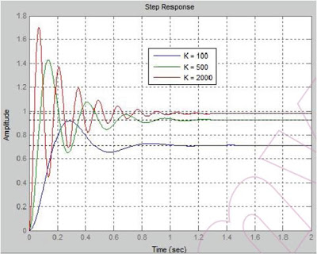
Clearly, it is not possible to achieve low steady state error and good transient response using only proportional control. As the gain is increased, the response becomes faster, but it has a lower phase margin. To remove the steady-state error and have better response, integral and/or derivative terms must be included in the controller.

Slide 5
PI Controller
In Proportional Integral mode, the controller make the following: Multiplies the Error by the Proportional Gain (Kp) and Added to the Integral error multiplied by Ki, to get the controller output. In the next figure we show an example of a P controller with different Proportional Gains.
The integral term (when added to the proportional term) accelerates the movement of the process towards setpoint and eliminates the residual steady-state error that occurs with a proportional only controller.
However, since the integral term is responding to accumulated errors from the past, it can cause the present value to overshoot the setpoint value (cross over the setpoint and then create a deviation in the other direction).

Slide 6
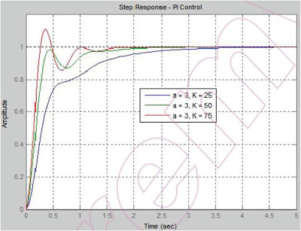
Integral control has removed the steady-state error and improved the transient response, but it has also increased the system settling time. Settling times can be lowered by increasing the gain. This will increase the system bandwidth, but it will also decrease the stability margin.

Slide 7
PD Controller
In Proportional Derivative mode, the controller make the following: Multiplies the Error by the Proportional Gain (Kp) and Added to the Derivative error multiplied by Kd, to get the controller output. In the next figure we show an example of a P controller with different Proportional Gains.
The derivative term slows the rate of change of the controller output and this effect is most noticeable close to the controller setpoint.
Hence, derivative control is used to reduce the magnitude of the overshoot produced by the integral component and improve the stability.
However, differentiation of a signal amplifies noise and thus this is highly sensitive to noise in the error term, and can cause a process to become unstable.

Slide 8
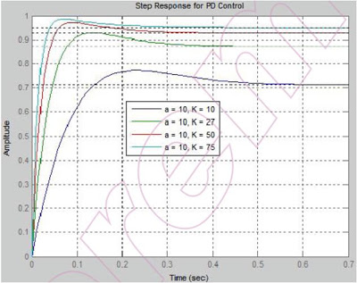
The PD controller has decreased the system settling time considerably; however, to control the steady-state error, the derivative gain KD must be high. This will decrease the response times and increase the bandwidth of the system and may make it susceptible to noise.

Slide 9
PID Controller
In Proportional Derivative Integral mode, the controller make the following:
Multiplies the Error by the Proportional Gain (Kp), Added to the Derivative error multiplied by Kd and Added to the Integral error multiplied by Ki, to get the controller output.

Slide 10
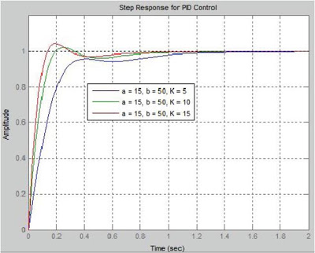
Using both integral and derivative control (PID) has removed steady-state error and decreased system settling times while maintaining a reasonable transient response.

Slide 11
PI, PD, PID Summery Characteristics
PD >> Compensator is anticipatory; it responds to the error and its derivative. >> Phase lead is provided starting one decade below the zero. >> Generally, increases damping and reduces %OS. >> Generally, reduces rise and settling times. >> Increases bandwidth. >> Increases phase and gain margins. >> May render a system susceptible to high frequency noise. >> Acts as a high-pass filter. PI >> Compensator increases the system type by one, which helps with error control. >> Increases phase-lag at low frequencies. >> Generally, increases damping, rise times, and settling times and reduces overshoot. >> Decreases bandwidth. >> Not sensitive to high frequency noise. >> Acts as a low-pass filter. PID >> Combined effects of PI and PD compensation. >> Cascade of a PI and PD compensator.

Slide 12
Procedure
There are number of ways/methods for PID tuning. The simplest among them(which I also used) is-
Set I and D term to 0, and adjust P so that the robot starts to oscillate (move back and forth) about the balance position. P should be large enough for the robot to move but not too large otherwise the movement would not be smooth.
With P set, increase I so that the robot accelerates faster when off balance. With P and I properly tuned, the robot should be able to self-balance for at least a few seconds.
Finally, increase D so that the robot would move about its balanced position more gentle, and there shouldn’t be any significant overshoots.

Slide 13
If first attempt doesn’t give the satisfying results , reset PID values and start over again with different value of P.
Repeat the steps until you find a certain PID value which gives the satisfactory results.
A fine tuning can be done to further increase the performance of PID system.
In fine tuning, PID values are restricted to neighboring values and effects are observed in practical situations.

Slide 14
Important Points
There is no clear boundary for taking P,I or D values and is mostly taken based on experience.
Theorotically,PID values depends on the state of the system.Ex. Mechanical Structure, Physical properties, Electrical properties(if any)etc.
But practically, it also depends on the external conditions.Ex. Atmospheric conditions etc.
PID values and method of choosing PID values depends largely on the characteristics of system. A method producing good result for a system may not work at all for another system with different characteristics.

Slide 15
What P,I & D values means practically
In case of Self-Balancing Robot-
P-P determines the force with which the robot will correct itself. A lower P shows robot’s inability to balance itself and a higher P will shows the violent behavior.
I-I determines the response time of robot for correcting itself. Higher the P, Faster it will response.
D- D determines the sensitivity of robot to the error in its state. It is used to smoothen/depress the robot oscillations. A lower D is unable to remove oscillations and a higher D will cause violent vibrations.

Slide 16
Self-Balance robot PID vs Quadcopter PID
PID method- A tuning method that works on quadcopter may not work on self balancing robot and vice versa.
I- Self balance robot require a very high I(~4xP in our case) where as in quadcopter, I is moderate(~P).
Mechanism to correct its position is different in both cases.Therefore,P,I or D may mean different in above cases.

